Slide 1
{Differential and Structural Staining} Acid-Fast , Endospore and Capsule Staining Week # 5
BT233 – General Microbiology Laboratory

Slide 2
Differential staining: is a staining technique that used to differentiate between different types of bacteria depending on certain cellular structures; mainly the cell wall.
Gram positive bacteria
Gram negative bacteria
Acid-Fast bacteria

Slide 3
Differential staining:
Gram Staining | Acid-Fast Staining
Used to differentiate between Gram positive & Gram negative Gram positive bacteria appear in violet color Gram negative bacteria appears in pink color Acid Fast bacteria can not be stained by Gram staining Acid Fast bacteria appears colorless throughout the procedure | Special technique used to stain the Acid Fast bacteria Uses STEAM (Heat) The Acid Fast bacteria contain a waxy-lipoidal material in their Cell wall (Mycolic Acid) Mycolic Acid is stain-proof Acid Fast bacteria appears in pink color Nonacid Fast bacteria appears in blue color

Slide 4
Acid-Fast Staining Technique: is a special staining technique, used to stain the Acid-Fast bacteria that can not be stained by other type of staining techniques
Acid-Fast Staining Technique depends on:
It involves using of a stain with a chemical nature that can interact with the waxy layer in the cell wall of acid-fast bacteria (lipid-soluble stain which contains phenol, such as carbol-fuchsin)
Using of heat (Steam) to assist the penetration of the stain through the cell wall by softens the wax

Slide 5
Acid-Fast Staining procedure:
Prepare one smear containing a mixture of Bacillus (non-Acid-fast) and Mycobacterium (Acid-fast)
Load the slide with the primary stain (Carbolfuchsin) and steam for 5 minutes
Discard excess stain and let the slide cool at room temperature for at least 5 minutes
Wash gently with decolorizing agent (3% acid-alcohol)
Immediately and gently wash with tap water
Load the slide with counterstain (Methylene blue) and leave to stand for 2 minutes
Wash gently with tap water
Blot dry with filter paper
Acid-fast bacteria appear pink, while non-Acid-fast bacteria appear blue

Slide 6
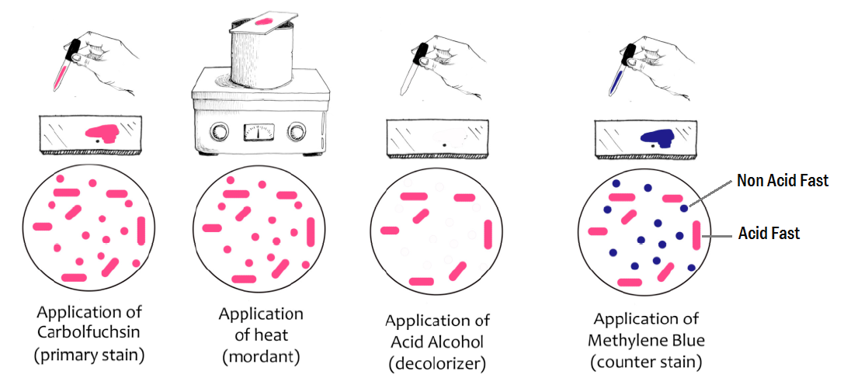

Slide 7
Acid-Fast Staining procedure:
Step | Effect | Cell Color
 |  | Acid-Fast bacteria | Non Acid-Fast bacteria
Primary stain (Carbol fuchsin) | Stain Both Acid-Fast bacteria (Mycobacterium) & Non Acid-Fast bacteria (Bacillus) with pink color | Pink | Pink
Steaming (Heat) | Convert (mycolic acid from the hard state into soft state Assist the penetration of Carbol fuchsin into Acid-Fast bacteria | Pink | Pink
Cooling | Convert the mycolic acid back into the hard state | Pink | Pink
Decolorizing agent (3% acid alcohol) | Remove the primary stain (pink color) from Non Acid-Fast bacteria | Pink | Colorless
Counterstain (Methylene blue) | Stain the Non Acid-Fast with blue color | Pink | Blue

Slide 8
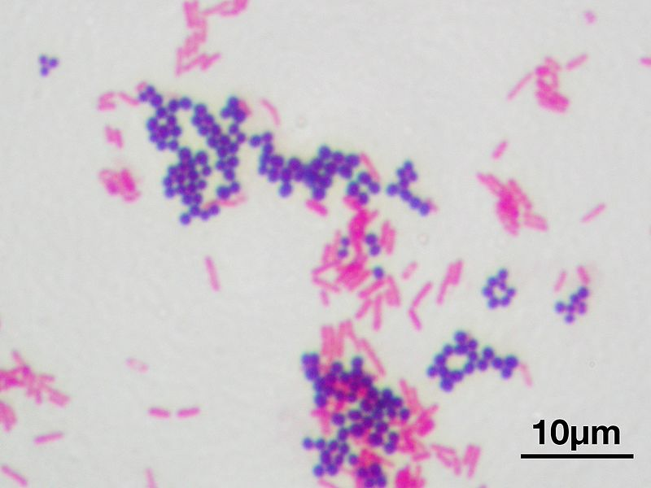
Acid-Fast bacteria retain Carbol-fuchsin and appear in pink color,
Non Acid-Fast bacteria will have the Methylene blue and appear in blue color at the end of the procedure

Slide 9
The smear must be cooled before decolorization, to allow the wax to harden
Decolorizing without proper cooling will let the stain to leave the Mycobacteria (the acid fast bacteria) and appear colorless at the end of the procedure, since Methylene blue, the counter stain, cannot enter these cells
- 3% Acid Alcohol = 3 units Acid + 97 units of Ethanol (absolute or 95%).
3% Acid-Alcohol is the best decolorizer to remove Carbol-fuchsin (it is strong enough to dissolve this stain).
- The affinity of the carbol fuchsin to the wax is higher than that to 3% Acid A lcohol ; SO, acid fast bacterial cells will retain the stain, while non acid fast cells will not.

Slide 10
What will happen if the cooling step is omitted during the staining technique?
The Mycolic acid will remain in the soft state, and the decolorizer will remove the carbol fuchsin from the Acid-Fast bacteria
The decolorizer act as a coolant, that causes the mycolic acid to convert into the hard state, So the end result will be a colorless Acid-Fast bacteria and blue Non Acid-Fast bacteria

Slide 11
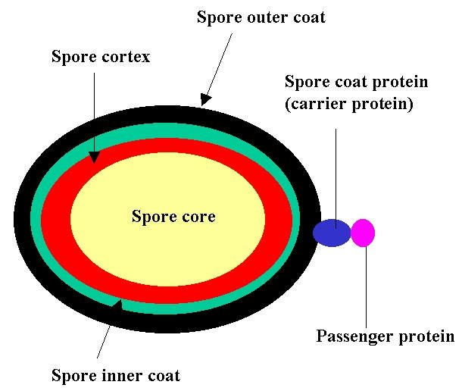
Endospore Staining
Spores: are highly resistant, dormant structures (i.e. no metabolic activity) formed in response to adverse environmental conditions. They help in the survival of the organisms during adverse environmental conditions
They do not have a role in reproduction
It contains a copy of the bacterial genetic material.

Slide 12
Some bacterial genera have the capacity to exist either as metabolically active vegetative cells or as highly resistant, metabolically inactive cell types called spores
When environmental conditions become unfavorable for continuing vegetative cellular activities, vegetative cells have the capacity to undergo sporogenesis and produce endospores, which are surrounded by impervious layers called spore coats
As conditions continue to worsen, the endospore is released from the vegetative cell and becomes an independent cell called a free spore
This is a natural process the organism performs to prevent annihilation & to ensure bacterial survival, since these spores are resistant to the harsh environmental conditions (excessive heat, freezing, radiation, desiccation, and chemical agents)
With the return of favorable environmental conditions, the free spore may revert to a metabolically active and less resistant vegetative cell through germination

Slide 14
Bacteria can be classified either Spore-Former OR Non-Spore-Former
Spore-Former bacteria can be classified either Exospore-Former (Streptomyces) OR Endospore-Former (Bacillus)
Endospore-Former bacteria can be classified based on:
- Position of Spore:
- Terminal
- Subterminal / Subcentral
- Central
- Shape of Sporangium:
- With swelling
- Without swelling

Slide 15
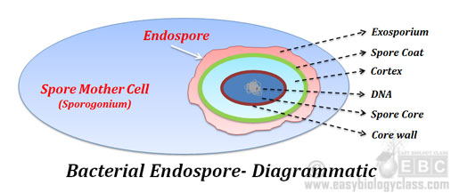
Endospore Staining
Endospore staining technique is used to check the presence and the position of the spore (central, terminal... etc); which is important to identify clinically important bacteria

Slide 16
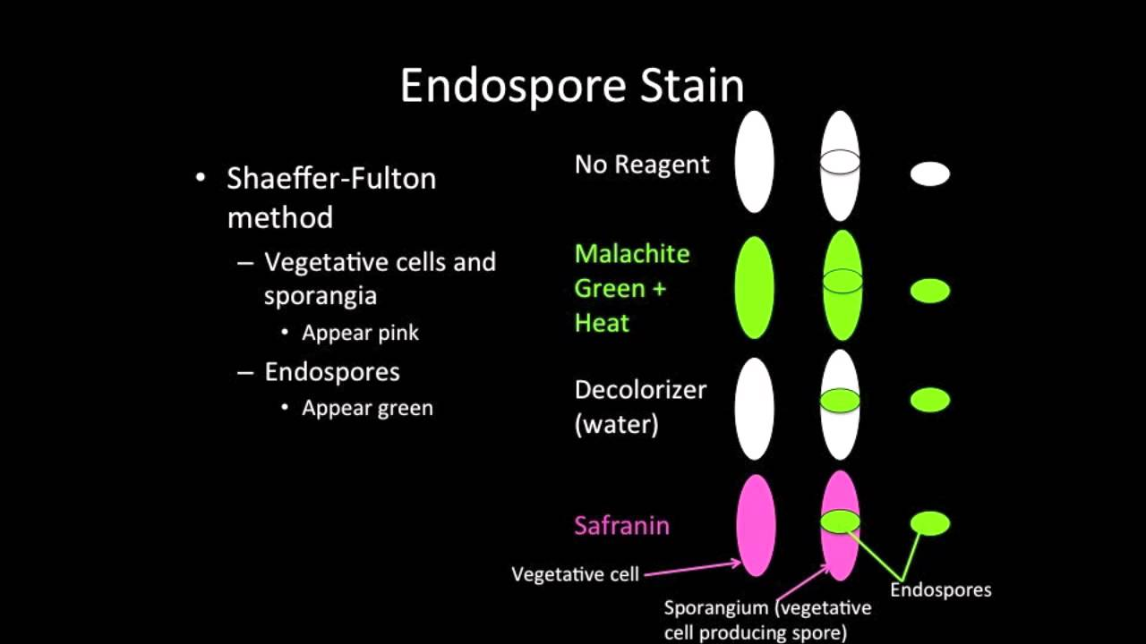
Endospore Staining
Prepare a smear of Bacillus with Gentle spreading and without heat-fixing
Load the primary stain (Malachite green), THEN, steam for less than 5 seconds.
Cool the smear at room temperature for at least 5 minutes
Decolorize by gently washing the slide with tap water
Load the counterstain (Safranin), and leave to stand for 1 minute
Wash gently by tap water to remove excess stain
Blot dry and Microscopy. (You will see Pink Vegetative cell with green endospore inside them).

Slide 18
Endospore Staining procedure
Step | Effect | Cell Color
 |  | Vegetative Cell | Endospore
Gently prepared Smear (Without heat fixation) | To prevent release the Endospores out of the vegetative cells | Colorless | Colorless
Primary stain (Malachite green) | Stain Both Vegetative Cell and Endospores with green color | Green | colorless
Steaming (Heat) | To open pores in the coat of the spore, because it is impervious | Green | Green
Cooling | To close pores in the coat of the spore | Green | Green
Decolorizing agent (Tap water) | Remove the primary stain (Green color) from Vegetative cells | Colorless | Green
Counterstain (Safranin) | Stain Vegetative cells with pink color | Pink | Green

Slide 19
Important points
The steaming step is the most critical step among the Endospore staining technique, where too much exposure to heat will cause the bacteria to release the endospore
Tap water is used as a decolorizing agent during Endospore staining: Because Both the water and the malachite green are polar (like dissolves like)
What will happen if the cooling step is omitted during the staining technique?
- The tap water will wash the malachite green from both the bacteria and the endospore
- The water will also act as a coolant, and close the pores of the spores, and the end result will be a colorless endospore and a pink bacteria

Slide 20
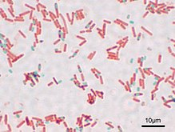
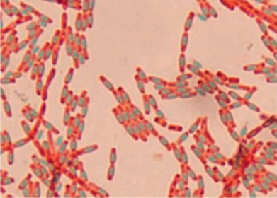

Slide 21
Capsule and Slimy layer
There are several types of bacteria that can produce certain polysaccharides and releasing them just outside the bacterial cell wall to form an outer layer (cover the outer part of the wall).
A distinct, Regular, tightly attached to the cell wall, gelatinous glycocalyx is called a capsule, whereas an irregular, diffuse layer, and loosely attached to the bacterial cell wall is called a slime layer.
Cells that have a heavy capsule are generally virulent and capable of producing disease (pathogenic)

Slide 22
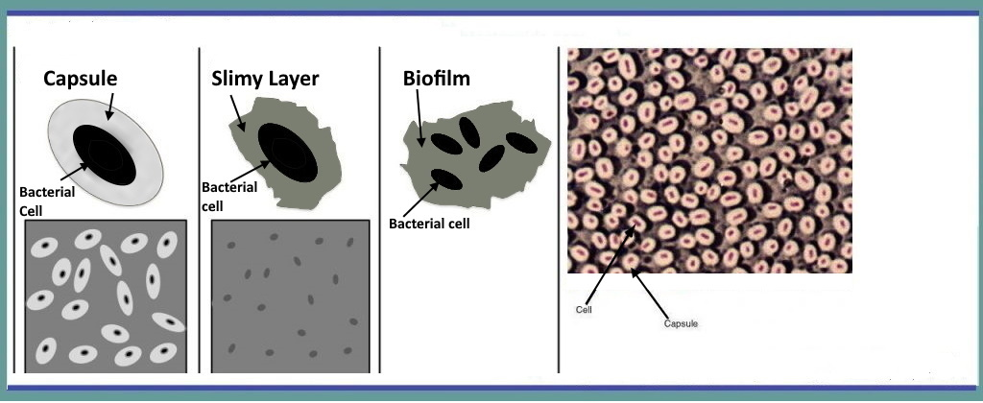
You must differentiate between:

Slide 23
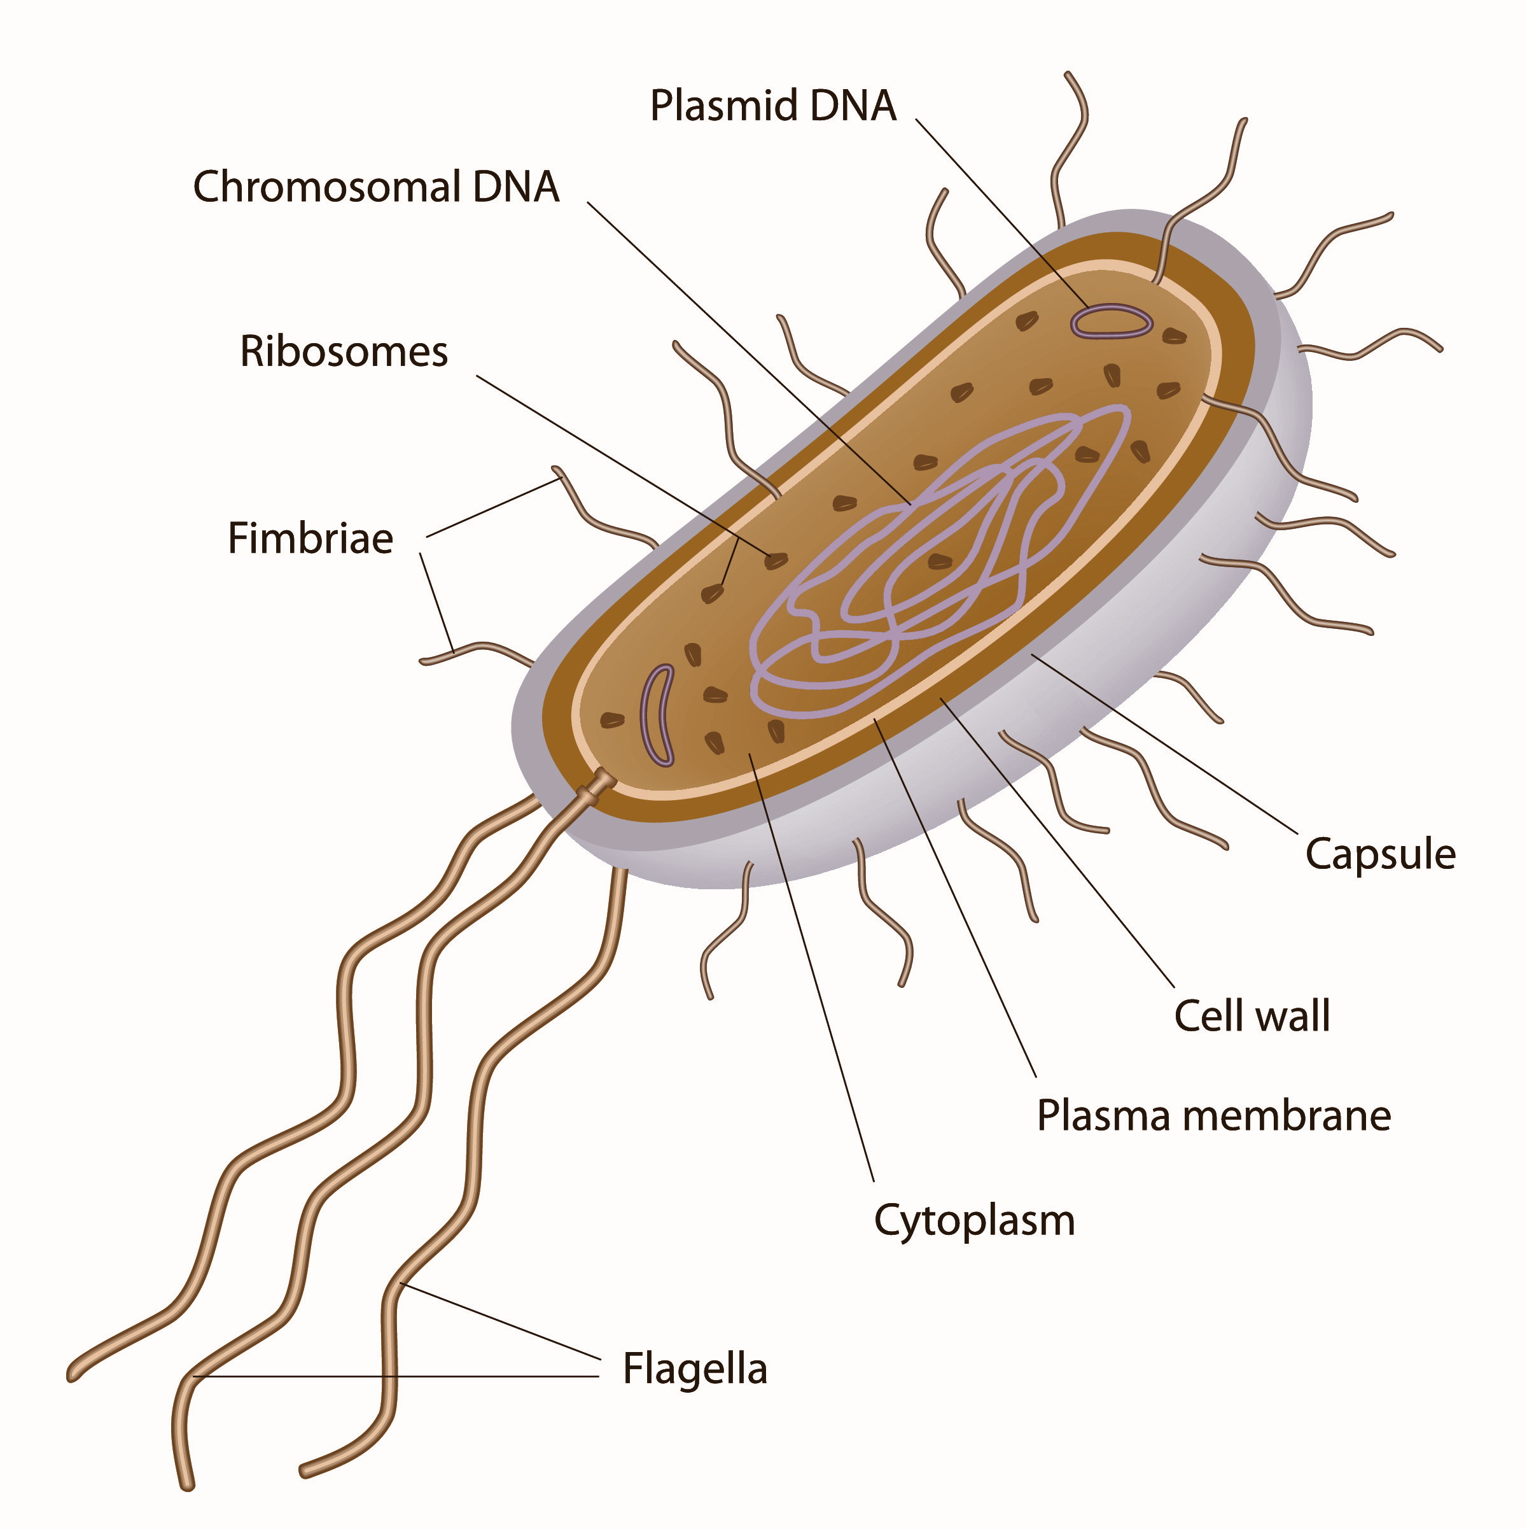
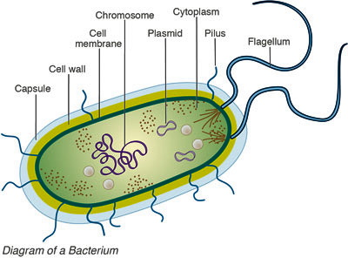
Capsule

Slide 24
Capsule
The capsule: is a polysaccharide film that extends beyond the cell envelope, It is a part of the bacterial cell's outer envelope.
It's a well-organized layer (regular) and tightly bound to cell wall that’s make it difficult to remove and can cause a variety of diseases.
Capsules are made of polysaccharides, some organisms, such as Bacillus anthracis, use other materials, such as poly-D-glutamic acid.
Since most capsules are so tightly packed and uncharged, most standard stains cannot penetrate the capsule, making them difficult to stain.

Slide 25
Functions of capsule
Increases bacteria's capacity to cause disease (a virulence factor).
The capsule protects the bacterial cells from phagocytosis.
Water that presents in the capsules, prevents the bacteria from drying out.
The capsule protects the bacterial cells from Bacterial viruses and most hydrophobic toxic products, such as detergents.
Capsules also aid in the adhesion of cells to surfaces

Slide 26
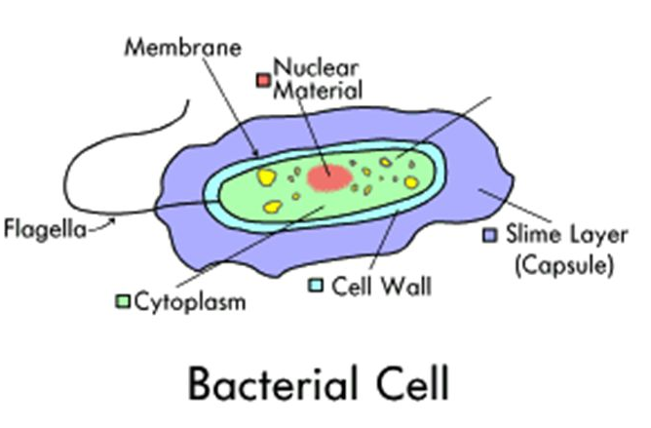
Slimy layer
A slimy layer in bacteria is an easily removable (even by subculturing of bacteria), unorganized layer (Irregular layer) of extracellular material that surrounds bacteria cells. It consists mostly of glycoproteins, glycolipids, and exopolysaccharides.

Slide 27
Slimy layer Functions:
Protect the bacteria cells from environmental dangers such as antibiotics and desiccation.
Allows bacteria to adhere to smooth surfaces such as prosthetic implants and catheters.
Over produced in a time of famine the cell can rely on the slime layer as extra food storage to survive.
Prevent unnecessary drying due to annual temperature and humidity shifts.
Permit bacterial colonies to survive chemical sterilization with chlorine, iodine, and other chemicals
A protective response to attacks from the immune system by using their slime layers to absorb antibodies and prevent phagocytosis.

Slide 28
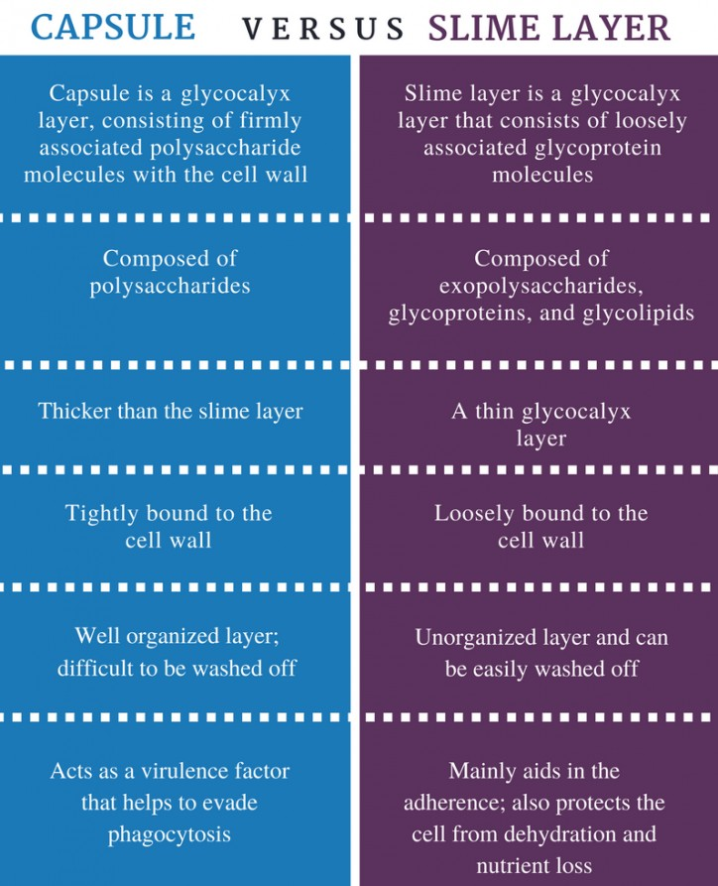

Slide 29
Capsule Staining:
In Capsule staining you must consider the following:
Staining of bacterial cells or bacterial structure depends on attraction and repulsion between the charge of bacterial cells or charge of bacterial structure and that
of the stain.
The Capsule and Slimy layer are uncharged. So, to stain it
we will use both:
A- Indirect simple staining: to stain the background(e.g.
the use of Nigrosine, India
ink, or Pelikan 4001)
B- Direct simple staining: to stain the bacterial cells (e.g.
the use of any Basic dye)
C. The unstained area around the bacterial cells that laid
between the stained cells and the stained background
is the Capsule.

Slide 30
Capsule Staining:
Capsule and Slimy layer dissolve in water and by heat. So, these must be not applied to capsule preparation.
If you want to wash the slide you use 40% CUSO4 this will wash the excess
of the stain, make a waxy Layer over the smear to fix it and prevent
washed out and give the capsule it’s shiny appearance.
If you want to stain the slimy layer, the bacteria must be taken directly from the sample because the slimy layer is loosely attached to the bacterial cell wall and washed out easily even by subculture the bacteria or growing it on artificial media.

Slide 31
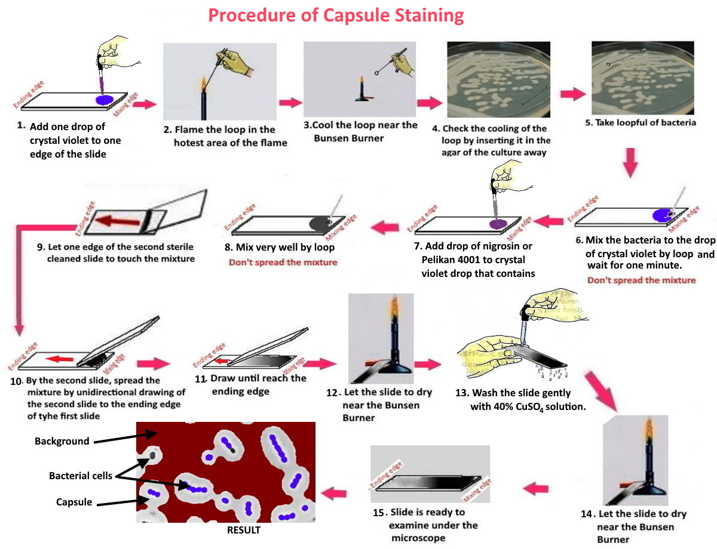

Slide 32
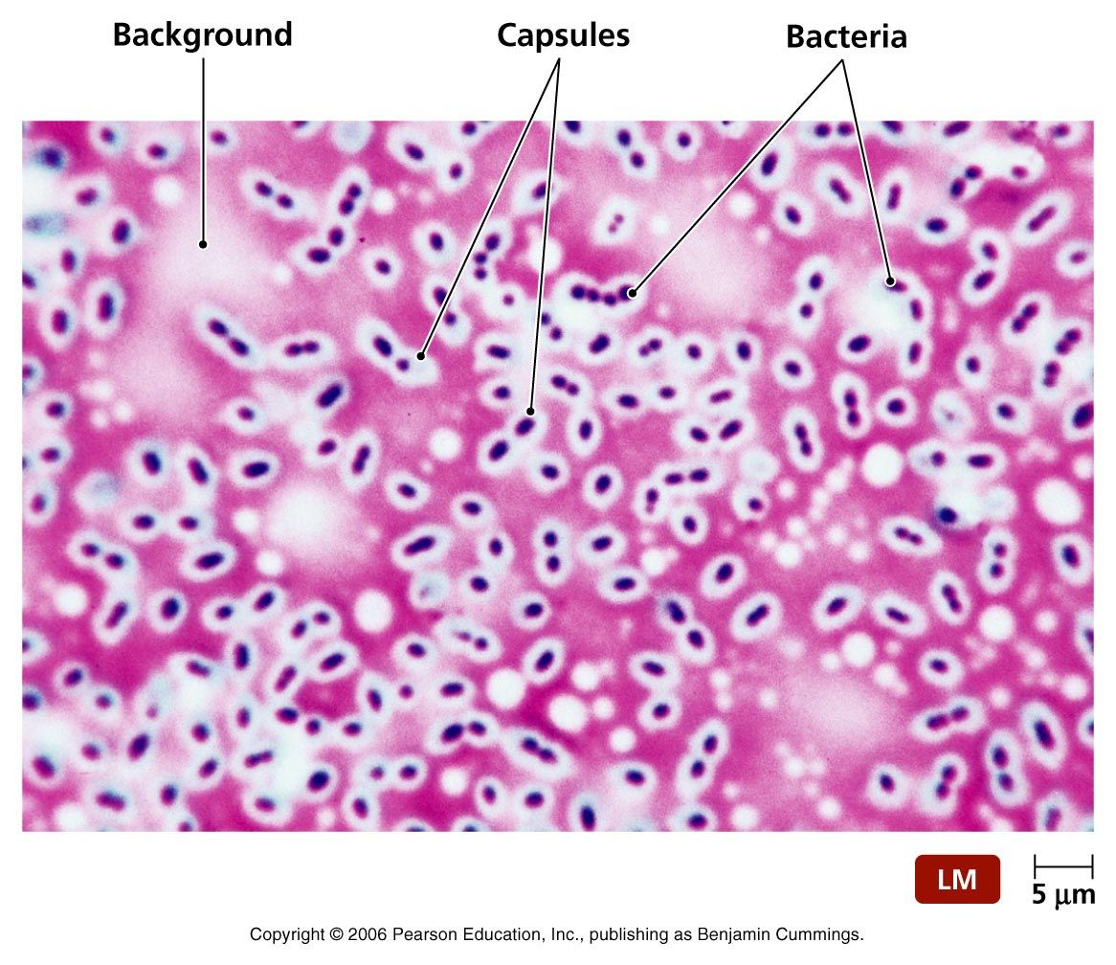
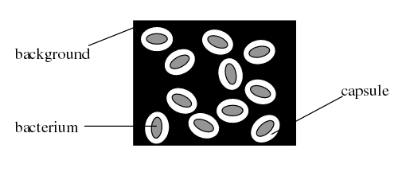
THE END

